Slide 1
Heart Failure Analysis
Predicting heart failure using patient demographics and lab work
By:
Trenton & Ashley Self

Slide 2
Heart Failure Background and Information
Cardiovascular disease (or CVD) is the number one cause of death in the world, killing an estimated 17.9 million people each year: this accounts for 31% of all deaths worldwide. Most cardiovascular diseases can be prevented by addressing behavioral risk factors early on, such as: tobacco use, unhealthy diet, obesity, physical inactivity, and alcohol consumption and/or abuse.
People with CVD, or who are at high cardiovascular risk due to the presence of one or more risk factors such as hypertension, diabetes, and hyperlipidemia, need early detection and management to prevent early death.

Slide 3
Overview of Data Distribution
The dataset is imbalanced: There are 89 more males than females; 1.83 times more. This would be worth investigating further as to whether more males responded than females, or if heart failure is more predominant in males than it is in females.
The ratio of patients who have died compared to those that were alive during the follow up period is promising: patients were alive more than 47.29% compared to those that died.
There are 2.11 times more smokers than non-smokers.
There are 1.39 times more non-diabetics compared to people diagnosed with diabetes.
There are 1.32 times more people without anemia than those with anemia.
There are 1.85 times more people that do not have high blood pressure compared to those that do.

Slide 4
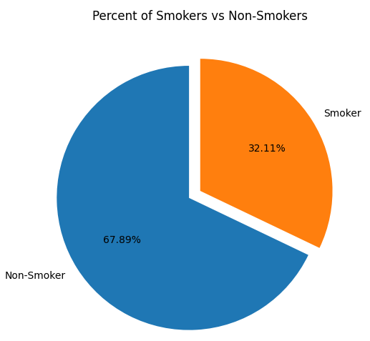
Distribution of Smokers
NOTE: It is interesting to see that, while the number of smokers is the exact same number of patients that died, not all smokers died during the collection of this data.
31.25% of smokers died
68.75% of smokers are alive
There were 45.45% more smoking patients alive during the follow up period than smokers that died: 2.2 times more smokers alive than dead.

Slide 5
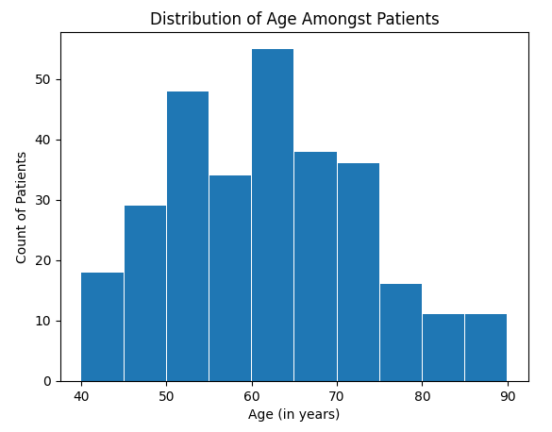
Distribution of Age
Regardless of sex, the age groups 50-55 and 60-65 years old had the highest number of patients.

Slide 6
Why are there more female deaths than male deaths in non-smoking patients, age 51 – 70?

Slide 7
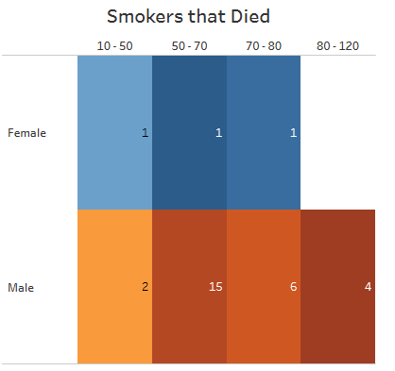
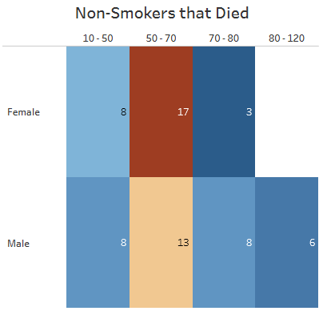
Count of Deaths in Smokers vs. Non-Smokers
Overall, there are more males that have died than females. However, the highest count in one age group happened in females that are non-smokers, age 51-70.

Slide 8
Attribute(s) of Females, Non-Smokers, Age 51 - 70
There are 60 females who do not smoke.
Out of the 60 females, 17 have died: 28.33%.
There are 11 patients that had low EF levels: 64.71% have died.
There are 4 patients that had low Serum Sodium levels: 23.53% have died.
There is only 1 patient that had low platelet levels: 5.88% have died.
There are 6 patients that had higher than 200 CPK levels: 35.29% have died.
However, there are only 2 patients within the high CPK group that have levels over 1,000: 11.76% have died.
There are 12 patients that had high serum creatinine levels: 70.59% have died.

Slide 9
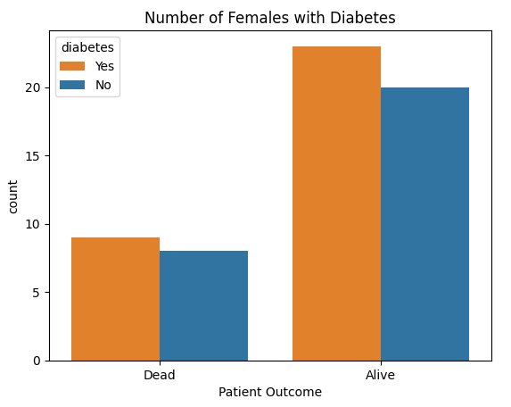
Females, age 51-70, Diagnosed with Diabetes
There are more females in this age group that have been diagnosed with diabetes that were alive during the follow up portion of this data collection. This could potentially indicate that most females were managing their diabetes and keeping their levels within a controllable range, thus decreasing complications for heart failure and/or death.
Females that died with a diabetes diagnosis:
Low ejection fraction was present in 67% of patients.
High creatine phosphokinase was present in 56% of patients.
High serum creatinine was present in 67% of patients.
11.76% of females that died were diagnosed with diabetes and had all three abnormal levels.

Slide 10
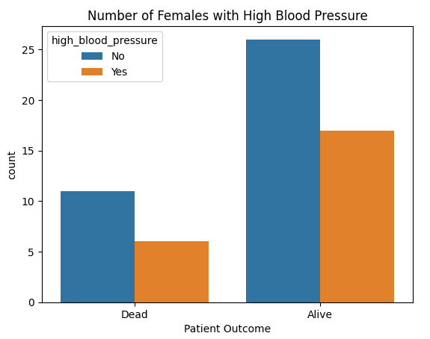
Females, age 51-70, Diagnosed with High Blood Pressure
There are more females without high blood pressure that have died than those diagnosed with high blood pressure: however, the same is to be said about the females that were still alive during the follow up.
Females that died with a high blood pressure diagnosis:
Low ejection fraction was present in 67% of patients (same percentage as diabetes).
High serum creatinine was present in 50% of patients.
5.88% of females that died were diagnosed with high blood pressure and had both abnormal levels.

Slide 11
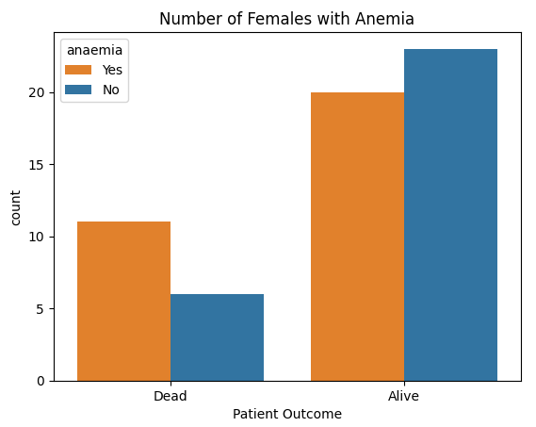
Females, age 51-70, Diagnosed with Anemia
There are almost double the number of females that have been diagnosed with anemia that were alive during the follow up period than there were those that died. The ratio climbs higher in females that were not diagnosed with anemia: alive females were present 3.83 times more than those that died.
Females that died with an anemia diagnosis:
Low ejection fraction was present in 64% of patients.
High serum creatinine was present in 55% of patients.
23.53% of females that died were diagnosed with anemia and had both abnormal levels.

Slide 12
Correlation(s) between Risk Factors
Out of the 17 non-smoking females, ages 51-70 that died, 11.76% were diagnosed with diabetes, high blood pressure, and anemia, and had low levels of ejection fraction.
Regardless of which risk factor a female has been diagnosed with, all three present an alarming rate of low ejection fraction levels: all three risk factors, in females that died, over 60% of patients had lower than 40% ejection fraction during the initial collection of data.
Unfortunately, there is not a big enough sample population, especially in females, to render a conclusive reason as to why this group of patients are dying more often than others.
Low ejection fraction and high serum creatinine levels were more prevalent amongst this group. Their condition was made worse, and had a high death rate, if they were diagnosed with diabetes, anemia, and high blood pressure. More testing over a longer period would be highly suggested so that healthcare can start adopting better and/or more policies to help predict, and reduce, heart failure diagnosis, and ultimately death.

Slide 13
Conclusion and Recommendation(s)
More collection of risk factors, outside of what was collected for this dataset, are needed in order to fully understand if there are any correlations between risk factors, bloodwork levels, and predicting the risk of death due to heart failure.
This dataset asked patients if they smoke, but failed to collect tobacco use, diet, obesity (specifically BMI levels), physical activity, and alcohol consumption.
This dataset only contains 299 patients, and there are roughly 6.2 million individuals in the United States of America that have been diagnosed with heart failure (CDC, 2023).
Out of the 17 females that died, 11 had low ejection fraction levels (64.71%) and 12 had high serum creatinine levels (70.59%). These levels are worth investigating further for preventative measures.
Recommendations for further investigation into ejection fraction and serum creatinine levels, cross-checking with other labs, symptoms, and underlying health conditions, should be the highest priority going forward in the healthcare field regarding heart failure prevention, diagnosis, and treatment; specifically for non-smoking females in the age range 51-70, and males across all ages.

Slide 14
References
CDC (2023, January 5). Heart Failure https://www.cdc.gov/heartdisease/heart_failure.htm
Chat GPT (2023). https://chat.openai.com/chat

